Slide 1
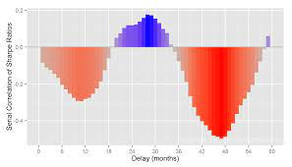

Performance Modelling View
Model Validator
UML collaboaration & activity diagram
Performance SRM model
Performance SRM model
Deployment phase
Service Specification
Performability evaluation
Model annotation phase
Model transformation phase
Model synchronization using guard functions
Phase for state machine generation
Dependability SRN model
Fig. 1: Performability Modelling Framework
Model Validator
Legend:
manual
Flow of operation
Model validation activity

